Slide 1
Crime Data Analysis in Nepal
Trends and Insights from Police Records
Presented by: Tejendra Magar

Slide 2
Introduction
Why crime data analysis is important in Nepal?
Crime is a grown concern in urban and densely populated areas.
Supports efficient allocation of limited law enforcement resources.
Contributes to public safety, awareness, and targeted interventions.
Analyzing crime data helps identify trends, hotspots, and recurring patterns.

Slide 3
Objectives
Analyze crime trends.
Examine how crime rates have changed over time in Nepal.
Identify High-Crime Areas.
Map and rank regions by crime volume to highlight hotspots
Support Data-Driven Decision-Making
Provide insights that help law enforcement and policymakers focus resources.

Slide 4
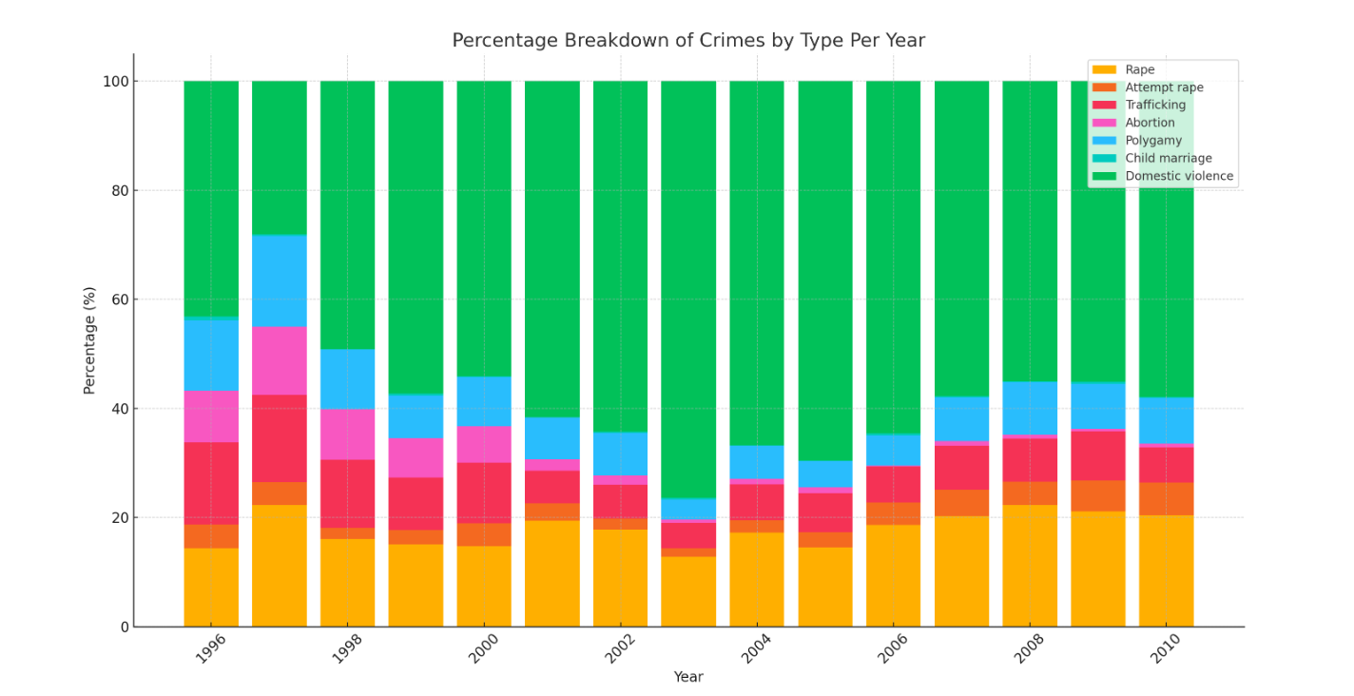
Total Crimes Over Time
Barchart of Total crimes by year

Slide 5
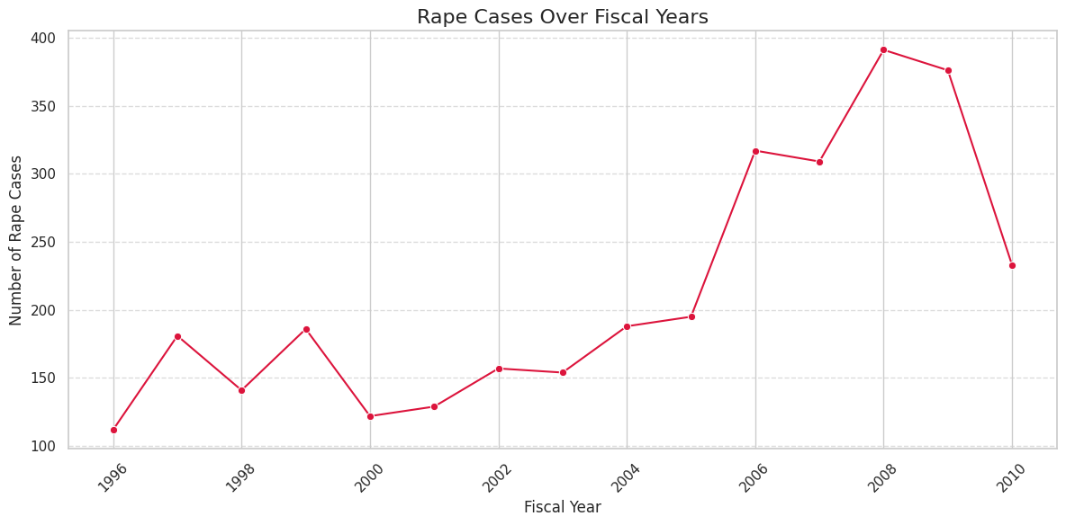
Rape case over Fiscal year
In 2008 there is high rape case that is 391.
In 1996 there is low rape case that is 112.

Slide 6
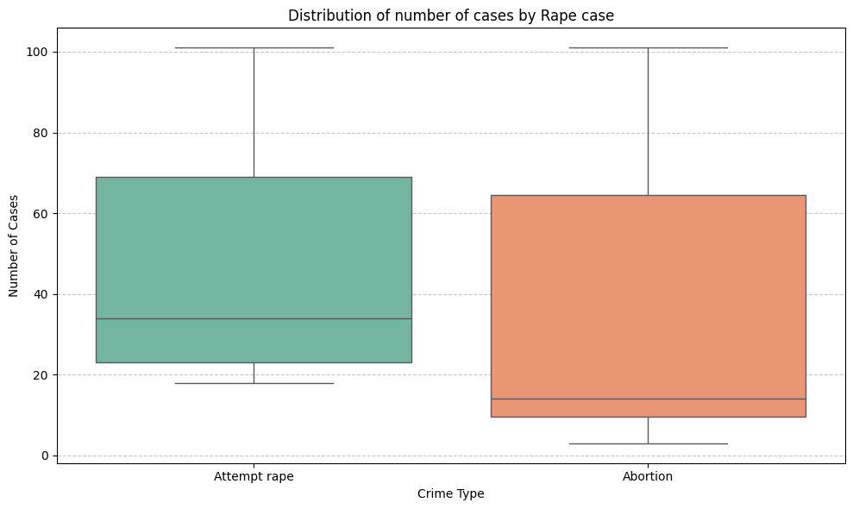
Distribution of number of cases by rape
The longer the box, the more dispersed the data - Attempt rape case have more dispersed data.
Median line of a box plot lies outside of the box of a each other, there is likely to be a difference between the two groups.
We see that the data point is not located outside the whiskers of the box plot thus presence of no outlier.

Slide 7
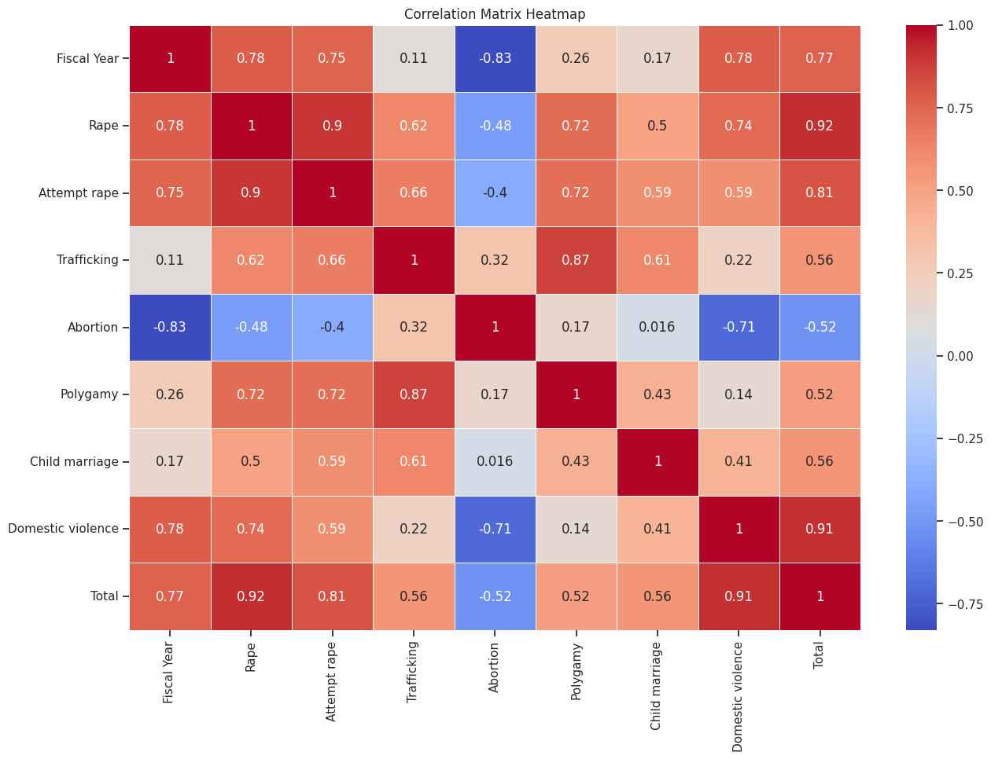
In above correlation matrix we painted the number so it will be easy for use to see which are highly corelated vale close to 1
"Rape" and "Abortion" have a correlation of -0.48, which indicates a moderate negative correlation which means that as one increases, the other tends to decrease, though not strongly.
And in "rape case" and "child marriage" have value 0.5 which is above 0.25 and we can say that they are strong correlation.

Slide 8
Recommendations
Increase surveillance in high-crime areas
Awareness program targeting theft during festival season
Data standardization for better record keeping

Slide 9
Limitation
Incomplete or missing demographic info
The dataset is limited to reported cases only
Regional inconsistencies in record keeping

Slide 10
Conclusion
“Data-driven crime is not just about numbers. It is a step toward building safer, smarter and more informed communities”

Slide 11
Thank You

